Slide 1
Visitor diary
C# .NET Project Using SQL Database
Group Members:-
Jeewan Bhusal
Jay Patel
Khushi Khetrapal
Kamaljeet Sangha
Harnoor Gill

Slide 2
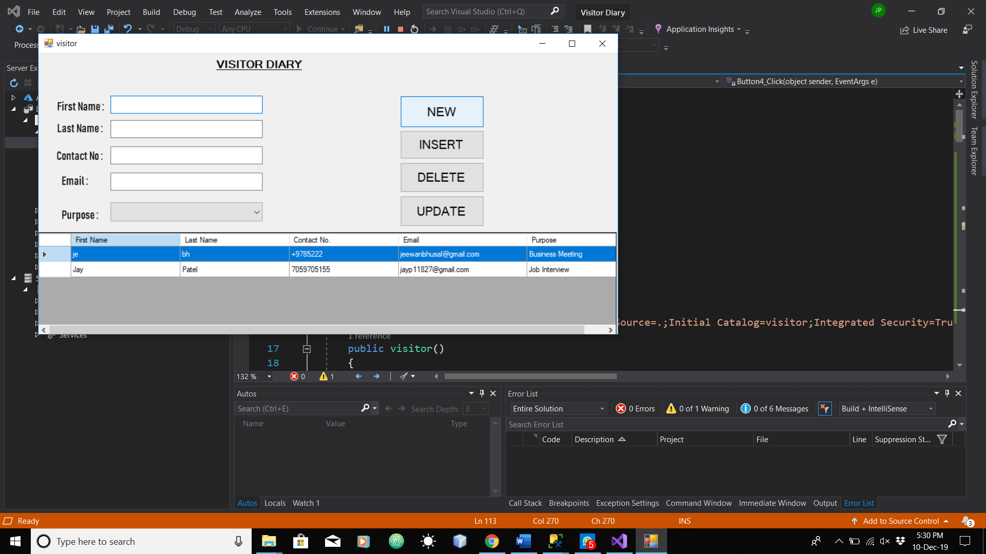

Slide 3
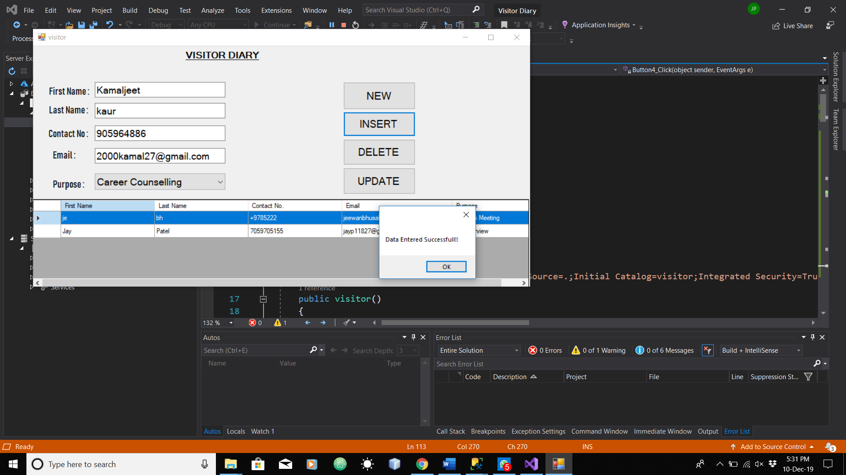

Slide 4
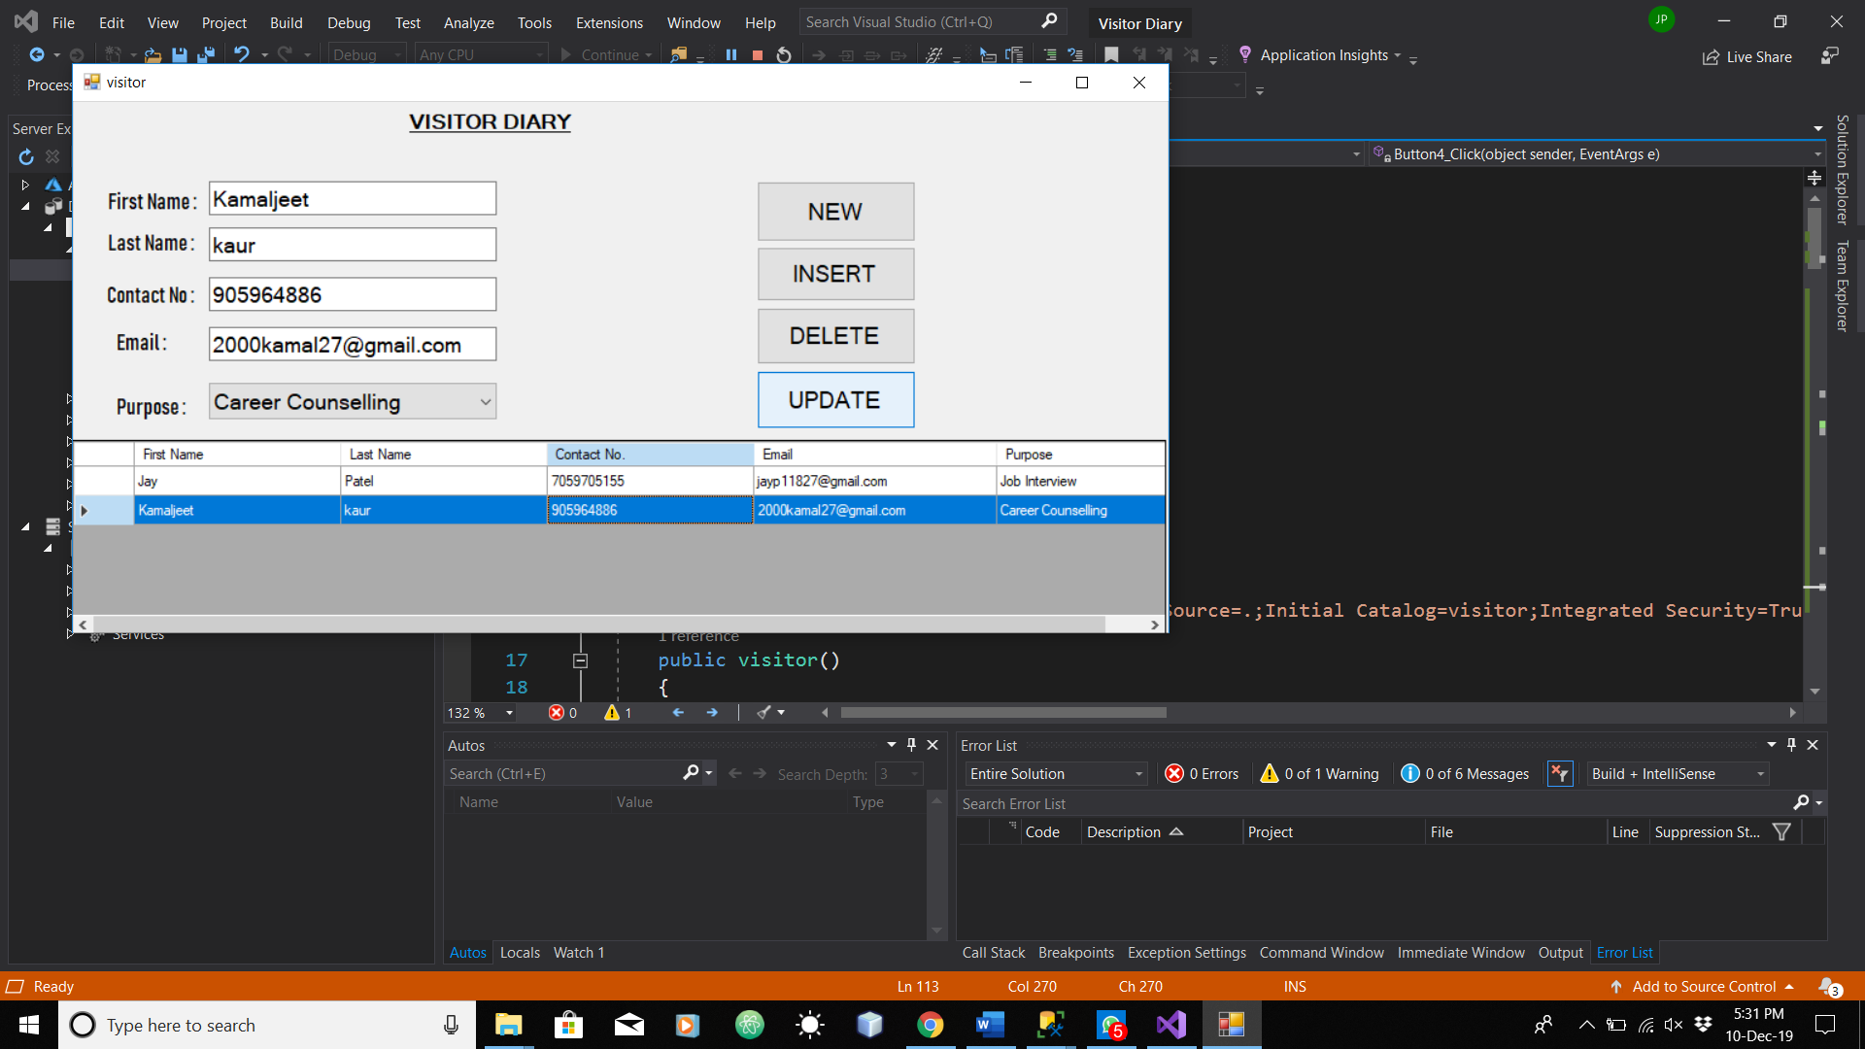

Slide 5
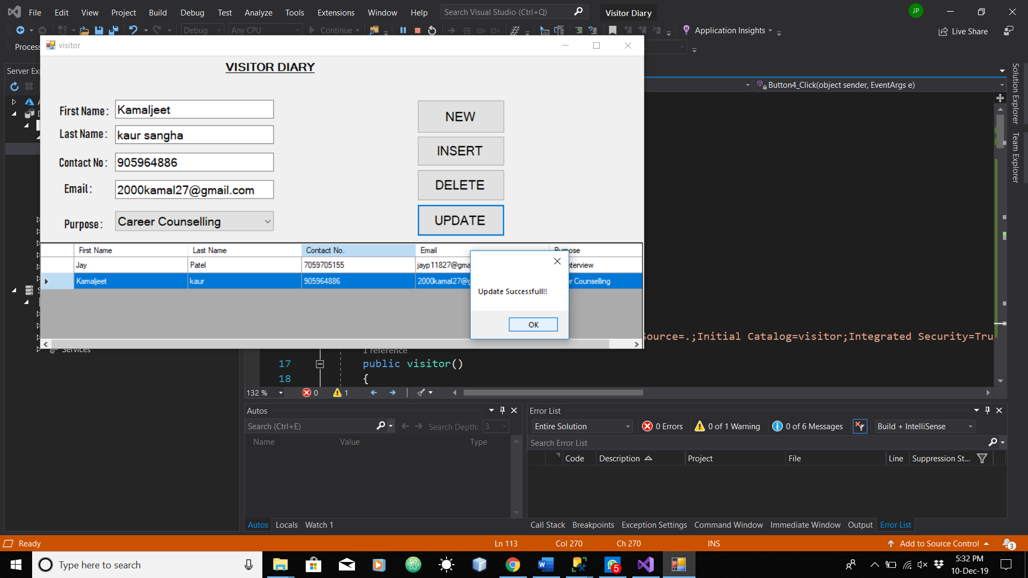

Slide 6
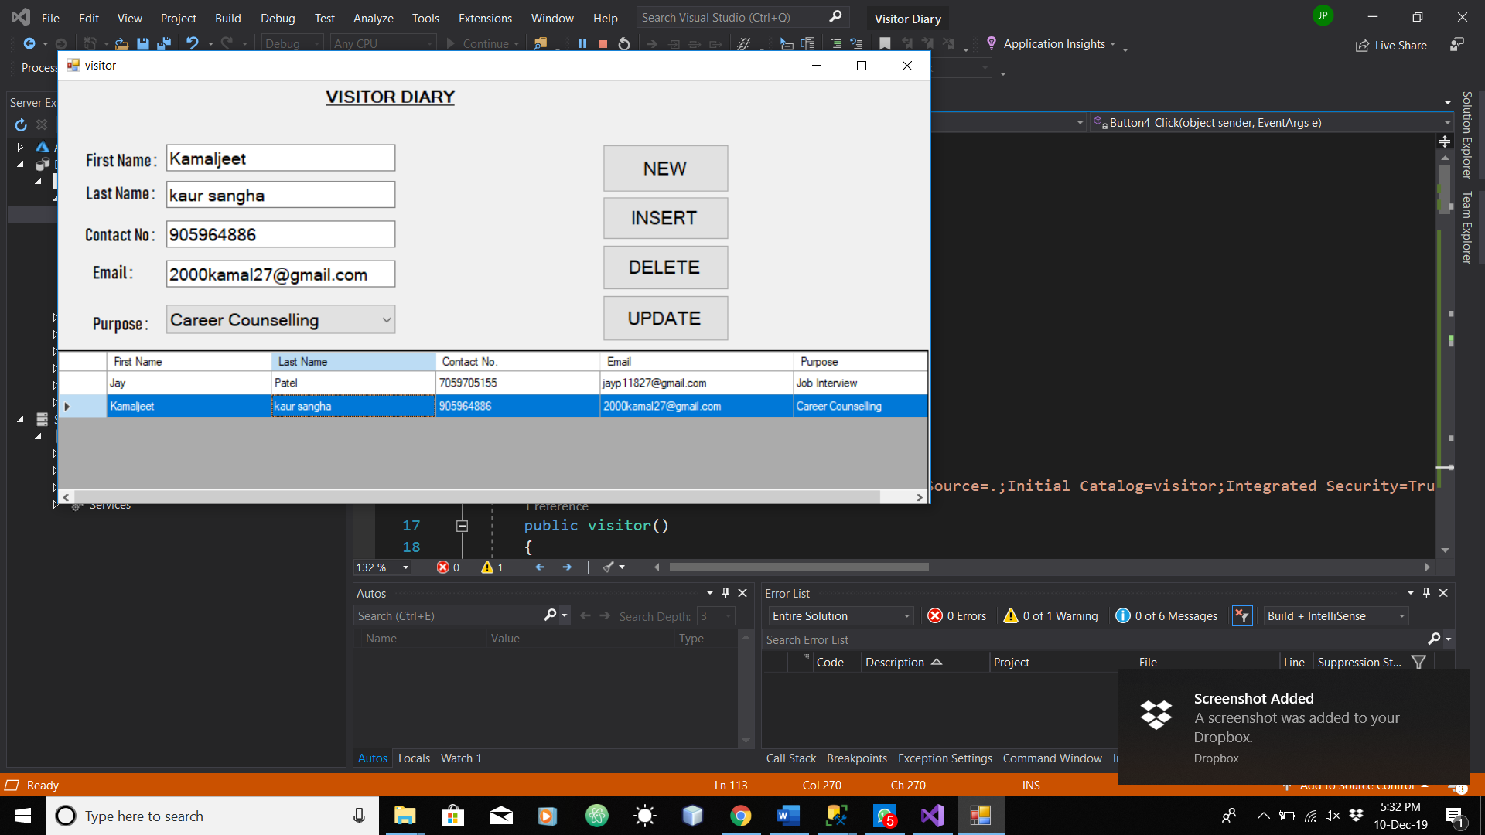

Slide 7
